Slide 1
Mini Project Phase – 0
Title: AI Loan Underwriting Assistant
Presented By
MITHARE ADITYA SAGAR USN: 1TD24AI105
NABIHA FATHIMA S USN: 1TD24AI112
ADITYA PRASAD USN: 1BY24AI007
ROHAN SUDEESH USN: 1TD24AI151
Under the guidance of
Prof. Pavithra G
Assistant Professor, Department of AI&ML
1

Slide 2
Content
    Introduction
    Problem Statement
    Objectives
    References : (IEEE format)
16-09-2026
2

Slide 3
Introduction
  Loan underwriting is the process of evaluating an applicant’s financial information, eligibility, and repayment capacity before a loan is approved.
  The process involves reviewing multiple documents such as identity, income, and financial records.
  Manual review can require repetitive extraction, cross-document verification, and financial analysis.
  Our project proposes a Multi-Agent Agentic AI system to assist loan officers in these tasks.
  Specialized agents handle document understanding, eligibility evaluation, risk assessment, and anomaly detection.
  The system consolidates the findings and generates an explainable recommendation, while the final decision remains with the human loan officer.
16-09-2026
3

Slide 4
Problem Statement
Develop a multi-agent AI-based Loan Underwriting Assistant.
Extract and analyze information from applicant documents.
Evaluate eligibility and repayment risk.
Detect inconsistencies across the application.
Generate an explainable loan recommendation.
Support the human loan officer's final decision.
16-09-2026
4

Slide 5
Objectives
Automate document understanding using OCR and document-processing techniques.
Evaluate loan eligibility using predefined lending conditions.
Assess repayment risk using extracted financial information and predefined rules/models.
Detect anomalies and inconsistencies across applicant documents.
Generate explainable recommendations with supporting evidence.
Provide a human-in-the-loop dashboard for loan officer review.
Maintain an audit-oriented record of the final outcome.
16-09-2026
5

Slide 6
References
[1] W. Wang et al., “Using Small Business Banking Data for Explainable Credit Risk Scoring,” Proc. AAAI Conf. Artif. Intell., 2020.
[2] M. Liu, “Assessing Human Information Processing in Lending Decisions: A Machine Learning Approach,” Journal of Accounting Research, 2022.
[3] N. Bussmann et al., “Explainable Machine Learning in Credit Risk Management,” Computational Economics, 2021.
[4] M. Tetteh et al., “Credit Risk Assessment with Madaline and Multilayer Perceptrons,” Springer, 2024.
[5] P. Jutasompakorn, A. Perdana, and V. Balachandran, “Enhancing Decision Making with Machine Learning: The Case of Aurora Crowdlending Platform,” 2023.
[6] N. Remolina, “The Role of Financial Regulators in the Governance of Algorithmic Credit Scoring,” SMU, 2022.
[7] Q. Wu et al., “AutoGen: Enabling Next-Gen LLM Applications via Multi-Agent Conversation,” ICLR Workshop, 2024.
16-09-2026
6

Slide 7
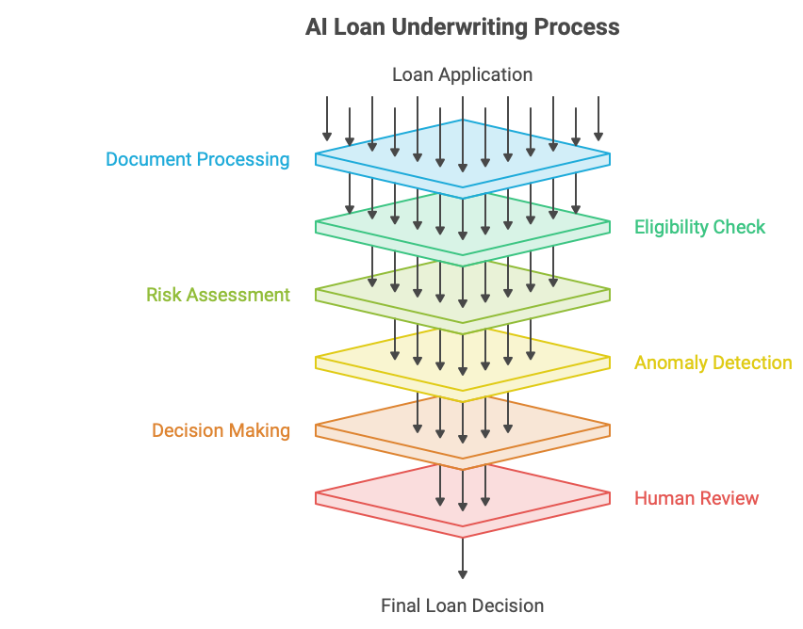
16-09-2026
7

